Slide 1
The funnels
The funnels

Slide 2
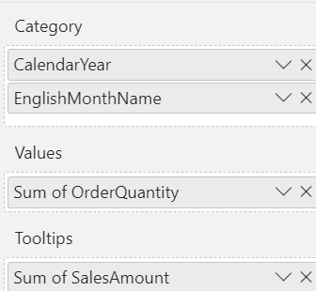
The funnels
This lab uses the AdventureWorks2016DW database
Add the Funnel visualization to the scene and configure the parameter values as shown in the table
Setting | Domain(s)
Category | Calendar year
 | Name of the month in English
Values | Quantity ordered
Tips | Sales amount

Slide 3
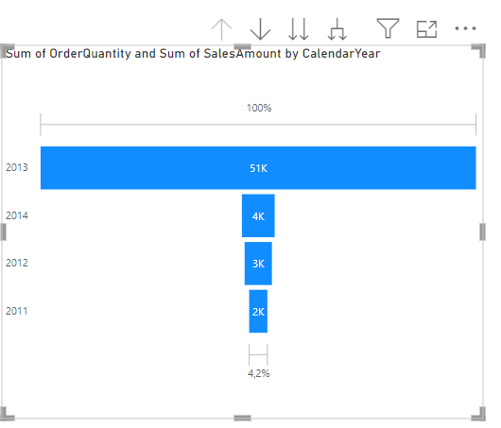
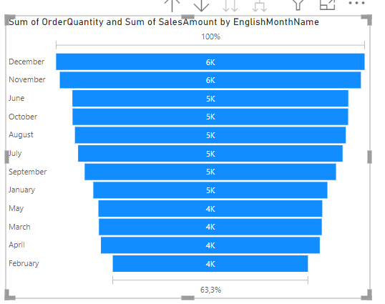
The funnels
Observe the funnel and try to execute Exploration operations provided by the menu at the top right

Slide 4
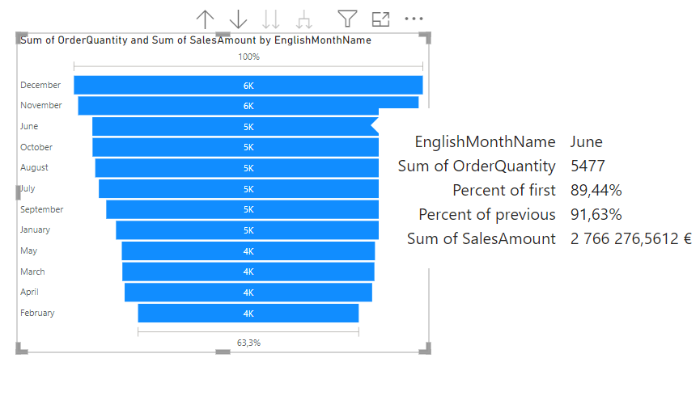
The funnels
Try hovering over one of the histograms

Slide 5
Thank you
Thank you

